Slide 1

Weekly Google Spam Rate Report 2/13/2026
Jacob Thomas
Data Scientist
Results Generation

Slide 2
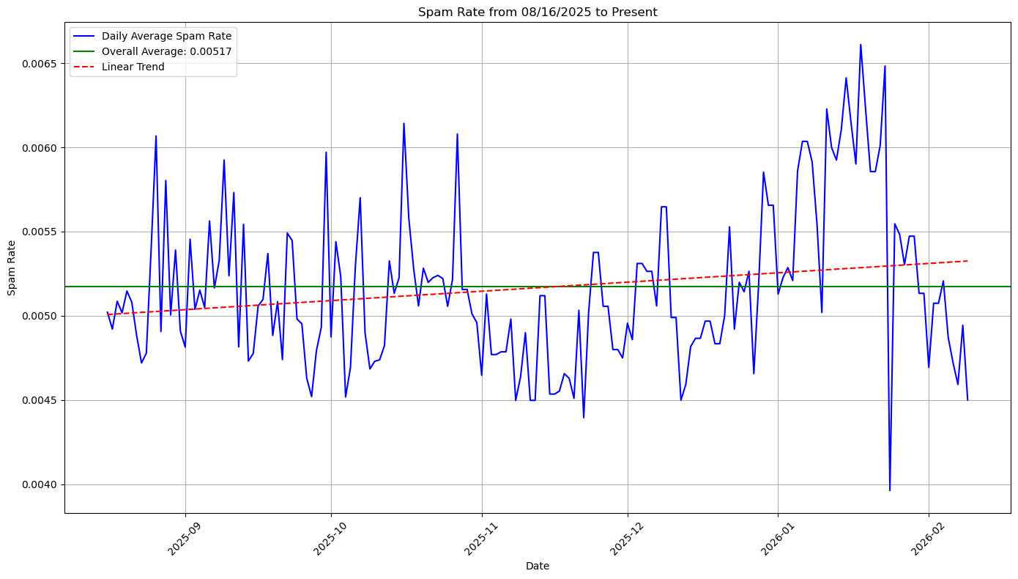
How is Spam Rate Trending Overall?
Current Overall Average Spam Rate across all Timepoints: 0.0051

Slide 3
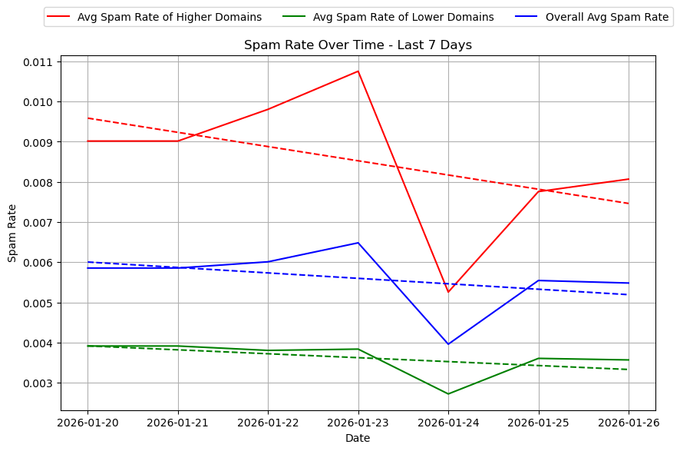
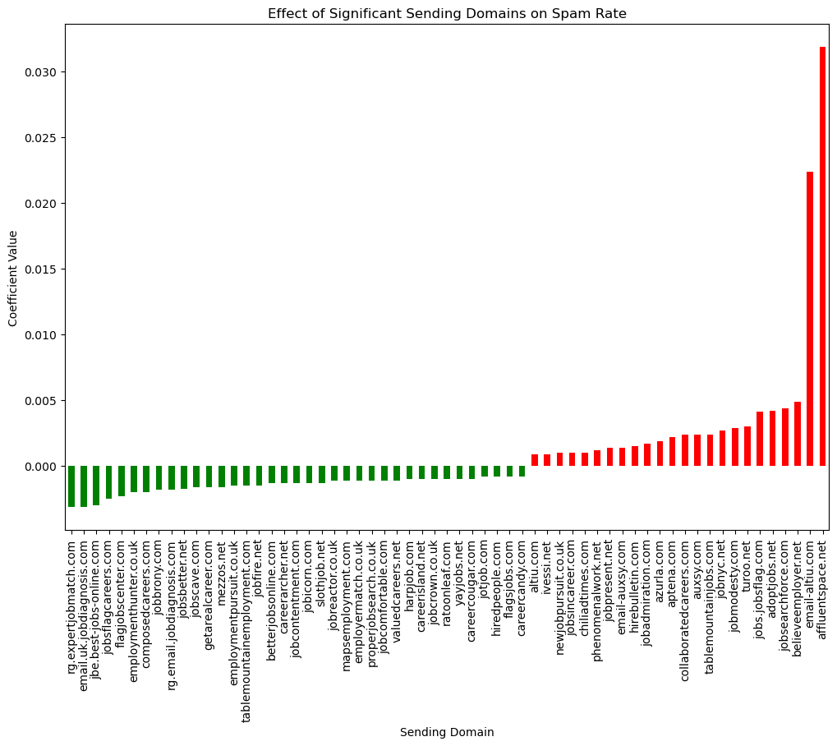
Which domains are significantly different than average over the last 7-days?
List of Significant Offenders: adoptjobs.net, affluentspace.net, altiu.com, aptena.com, auxsy.com, azurla.com, believeemployer.net, chiliadtimes.com, collaboratedcareers.com, email-altiu.com, email-auxsy.com, hirebulletin.com, ivessi.net, jobadmiration.com, jobmodesty.com, jobnyc.net, jobpresent.net, jobs.jobsflag.com, jobsearchforce.com, jobsincareer.com, newjobpursuit.co.uk, phenomenalwork.net, tablemountainjobs.com, turoo.net
There are 24 domains that are significant offenders.

Slide 4
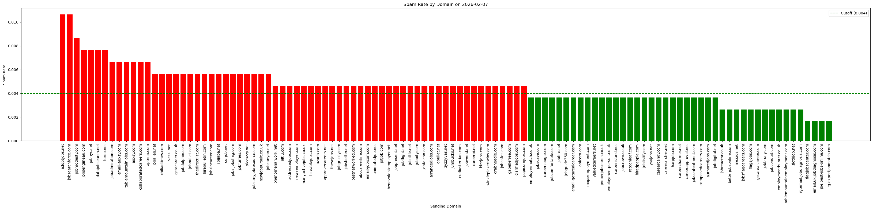
Which domains currently have Spam Rate > 0.4%?
Domains with a Spam Rate greater than 0.004: aptena.com, careerpi.net, jobfalcon.com, jobfurries.com, newjobpursuit.co.uk, joblittle.net, jobcanyon.net, drabneedle.com, jobuliet.net, pizzazzy.net, gabellefree.com, pupicornjobs.com, ourjob.net, auxsy.com, arrangedjobs.com, jipijapa.net, zyzzyvas.net, jumbucks.net, nudiustertian.com, tablemountainjobs.com, jobwend.net, bizzjobs.com, jobbity.com, jobcafes.com, jobsincareer.com, chiliadtimes.com, clarifiedjobs.com, jobbullet.com, adoptjobs.net, winklepickertwins.com, jobgrizzly.com, jobpresent.net, addressedjobs.com, thedirectlist.com, jobdolphin.com, jobflight.net, hireablejobs.com, getacareer.co.uk, altiu.com, thesejobs.net, approvecareers.net, jobadmiration.com, turoo.net, bestnetworked.com, ivessi.net, abccareerline.com, jobmodesty.com, jobnyc.net, jotjob.com, hirebulletin.com, phenomenalwork.net, jobalien.net, benevolentemployer.net, animatedjob.net, email-auxsy.com, email-jobicorn.com, datajobsearch.net, jobsbetter.net, jobs.myjobresource.com, collaboratedcareers.com, azurla.com, manyactivejobs.co.uk, jobsearchforce.com, jobs.jobsflag.com, newsemployer.com, jobsengineau.com
There are 66 domains that are >0.4% and require action.

Slide 5
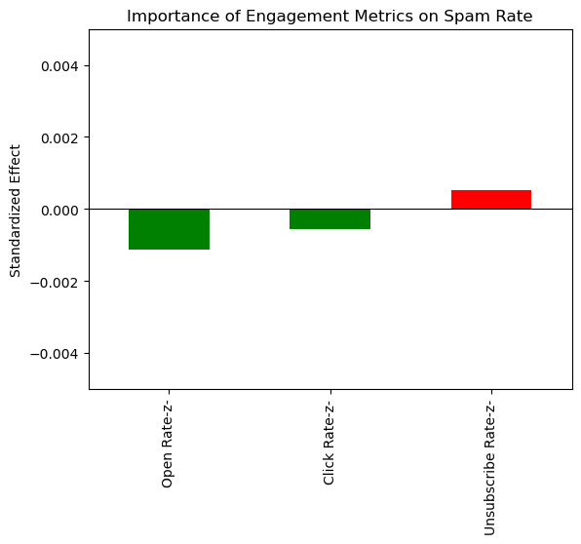
How has engagement been affecting spam rate the most over the last 7-days?
Open Rate has the strongest significant inverse correlations. Click rate also has a significant inverse correlation with Spam Rate. Unsubscribe rate has a positive correlation.

Slide 6
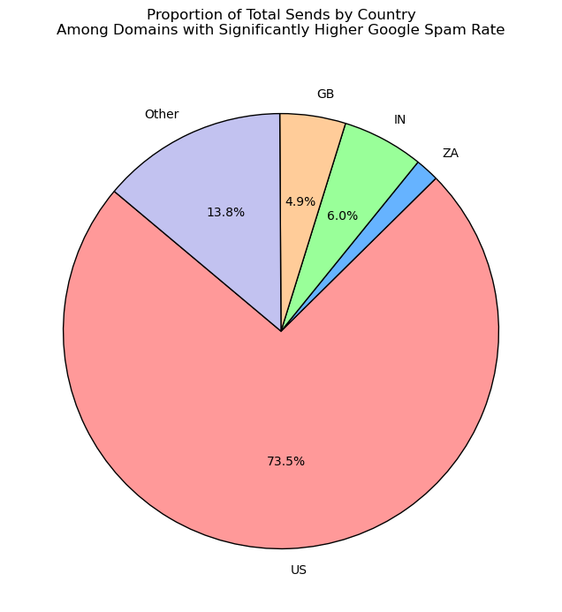
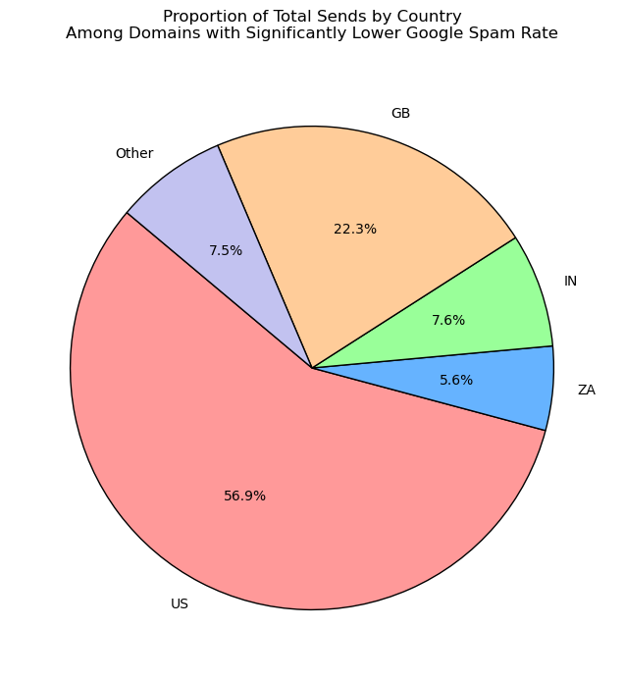
How has the balance of sends across countries been affecting spam rate over the last 7-days?
Higher Spam Rate domains have more US and Other, whereas lower Spam Rate domains have more GB, IN, and ZA.

Slide 7
What tests are running that target spam rate, and how are they going?
🔴 Chronic Domains
Still significant from last month Action: Manual adjustments adoptjobs.net, altiu.com, auxsy.com, azurla.com, bestnetworked.com, careerisland.net, email-altiu.com, email-auxsy.com, jobbmore.com, jobleague.net, jobprowl.net, jobsearchforce.com, turoo.net
We applied the algorithm to identify chronic, acute, and prophylactic domains on 2/3. Deliverability team is doing manual adjustments on Chronic domains. No other tests are running.

Slide 8
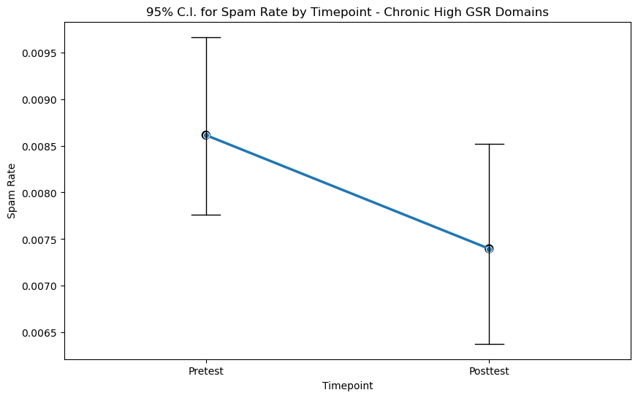
What tests are running that target spam rate, and how are they going?
Chronic domains have not yet experienced significantly reduced spam rate (b=-0.001, p=0.12)

Slide 9

What are the recommendations?
Overall Spam Rate is tracking towards improving. Chronic domains are approaching a trending decline after a short period of manual adjustments.

